Slide 1
Exploring New Customer Markets
Samuel Yohannes
Paul Strader
Adam Vajdak
Paul Phillips
Notes:
Sam

Slide 2


Customer Segmentation
Companies who have achieved success in a region often want to expand their product vision and profitability by launching in new markets.
Customer segmentation puts the right information in front of the right audiences, increasing awareness, engagement, and sales.
Notes:
Customers have an infinite number of options at their fingertips, so how can you stand out from the crowd and achieve customer loyalty?” One of these approaches from a marketing standpoint is appropriate customer segmentation.
The segmentation process begins by grouping customers and potential customers into customer segments with similar characteristics, such that you can communicate to all the individuals in that segment efficiently, yet still effectively.” This process facilitates proper allocation in limited resource environments.

Slide 3
Key Terminology – Probably don't need
Discussion points, build off previous slide for others?
Customer Segmentation
Categories (Archetypes)
Spending Score

Slide 4
Overviewverview
An automobile company has plans to enter new markets with their existing products (P1, P2, P3, P4, and P5).
In their existing market, the sales team has classified all customers into 4 segments (A, B, C, D ).
They plan to use the same strategy for the new markets and have identified 2627 new potential customers.
Notes:
Our mandate is to help management of an automobile company, predict the right group of the new customers
After intensive market research, they’ve deduced that the behavior of the new market is similar to their existing market.
Then, they performed segmented outreach and communication for a different segment of customers. This strategy has work e exceptionally well for them. They plan to use the same strategy for the new markets and have identified 2627 new potential customers.

Slide 5
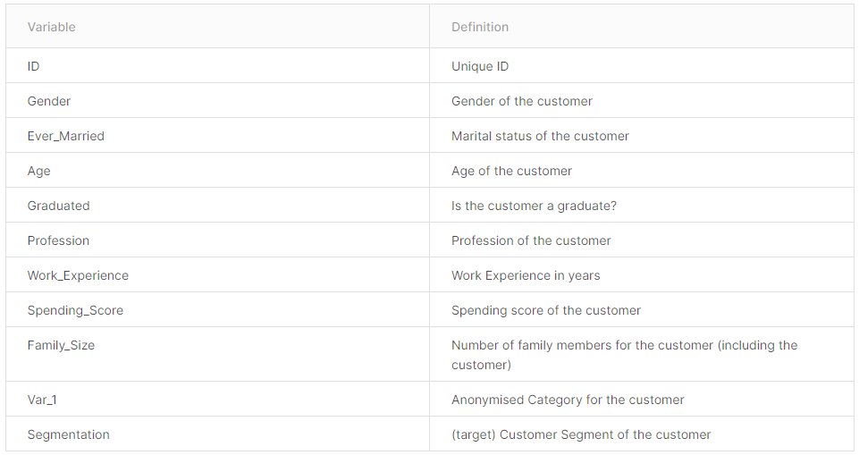
About the Data This dataset contains 10 demographic features and target class, Customer Segmentation: A, B, C, D for over 8,000 observations.
Notes:
Sam

Slide 6
Methodology – Not needed
Data Preparation
Exploratory Data Analysis
Visual & Statistical Trend Discovery
Association Rule Mining
Clustering
Classification

Slide 7
Data Preparation
Character Columns to Nominal
Integer-Ranged Columns to Ordinal
Bin Age Column & Convert to Ordinal
Yes/No Response-Based Columns to Boolean
Missing Data
Is the present missing values correlated between columns?
If missing values are removed, will doing so impact the customer segmentation and category columns in an imbalanced manner?
Notes:
Sam

Slide 8
Exploring Missing Values
Column Name | Percent of Rows Missing Data
Work Experience | 10.3 %
Family Size | 4.2%
Ever Married | 1.7%
Profession | 1.5%
Graduated | 1.0%
Spending Score | 0.9%
Total Rows Impacted | 17.4%
Notes:
Paul P

Slide 9
Exploring Trends in Training Data
Notes:
Paul P

Slide 10
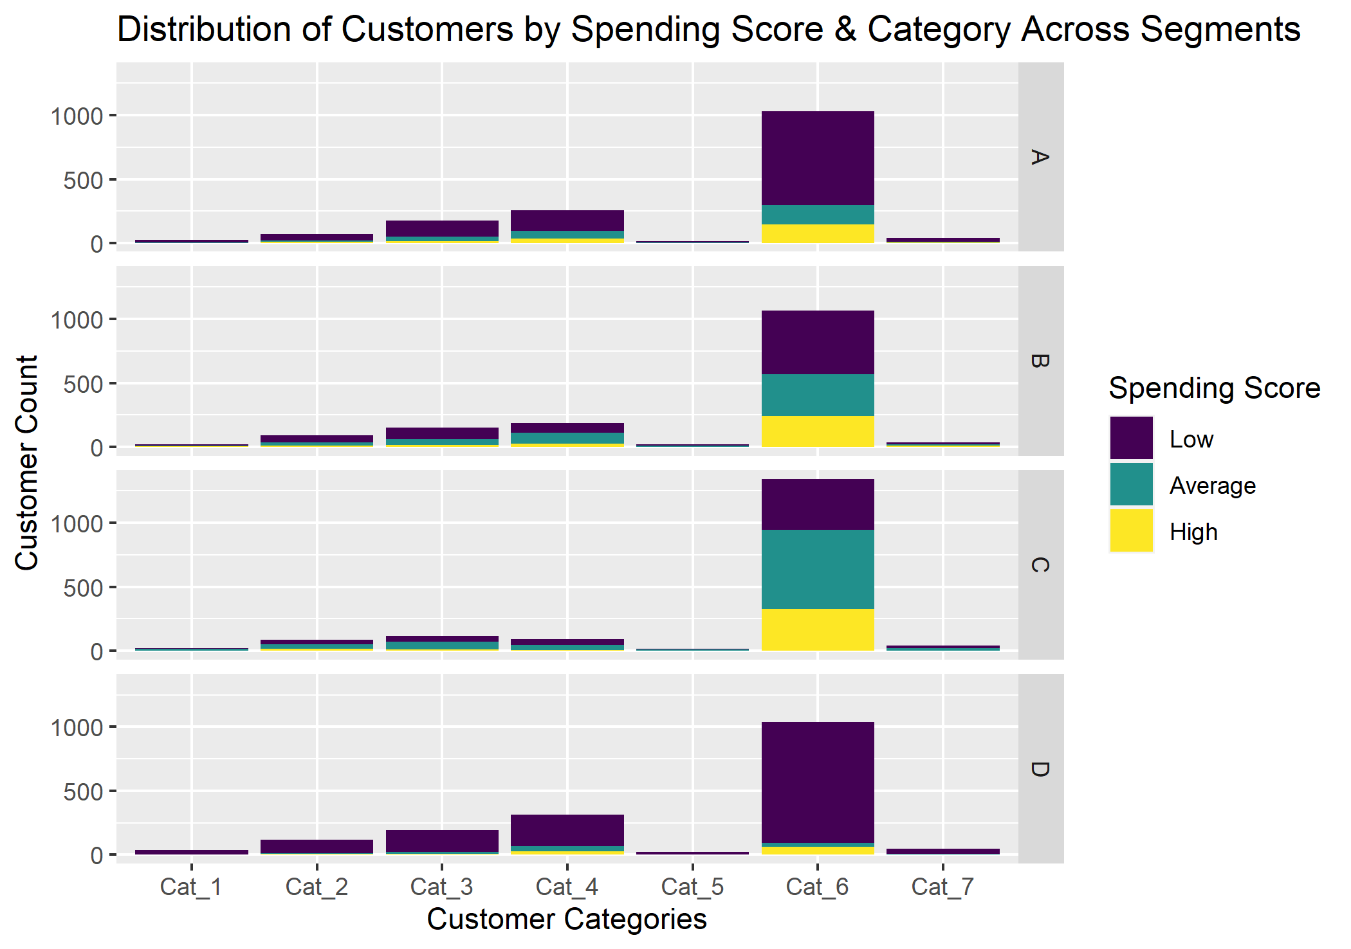
Customers by Category Are Skewed
Notes:
Paul P or Adam

Slide 11
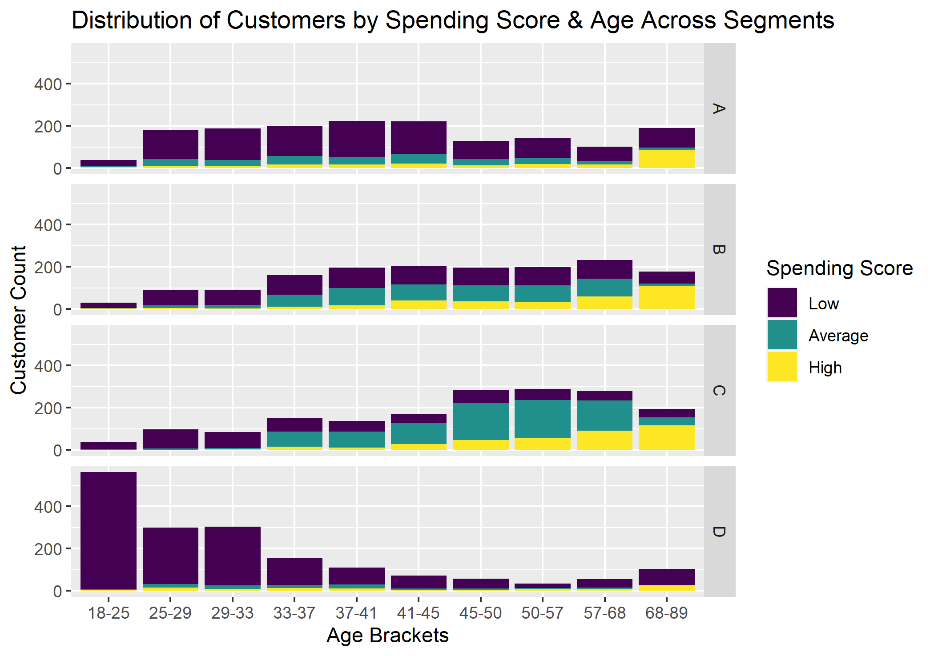
Age & Spending Score Offer Distinguishable Differences Between Segments
Notes:
Paul P or Adam

Slide 12
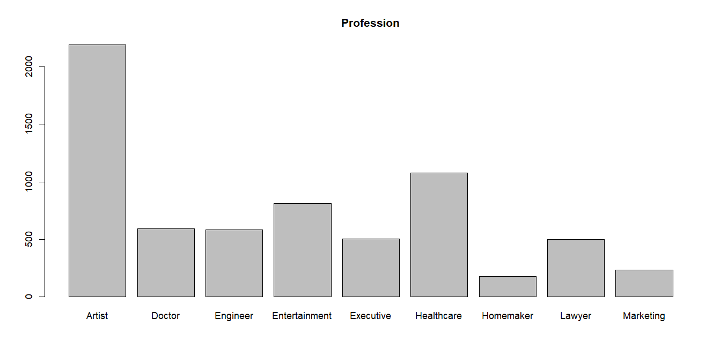
Client Base Predominately Consists of Artists
Notes:
Paul P or Adam

Slide 13
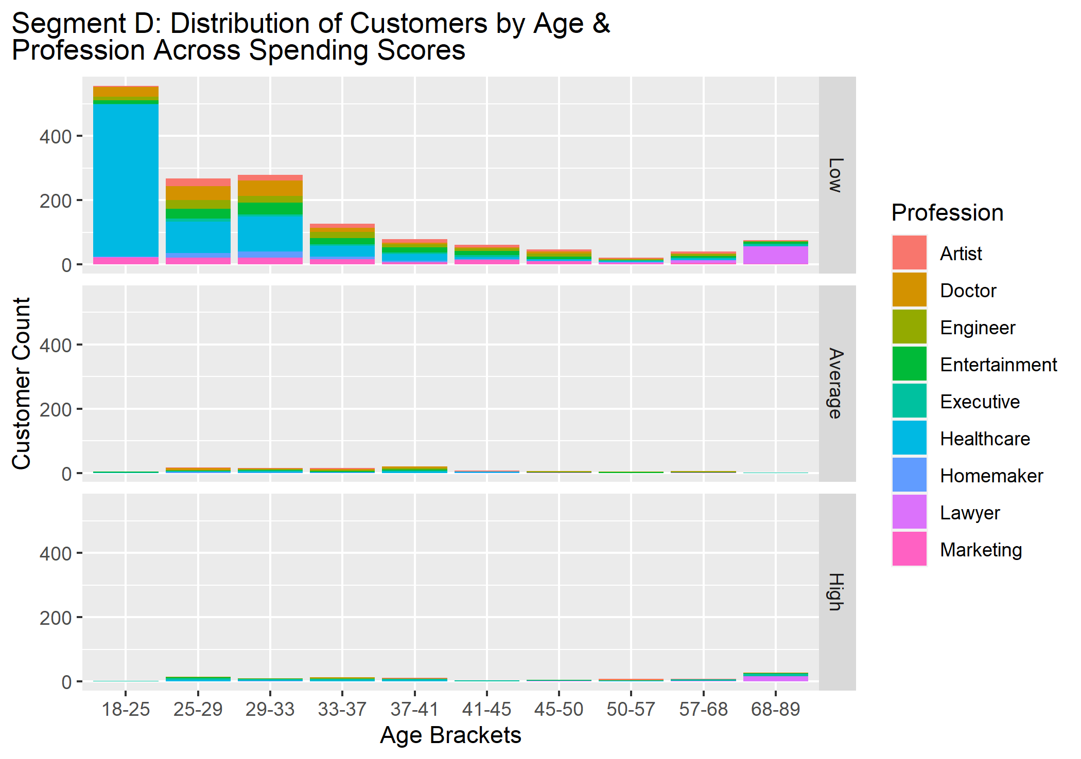
Profession Distinguishes Segments
Notes:
Paul P or Adam

Slide 14
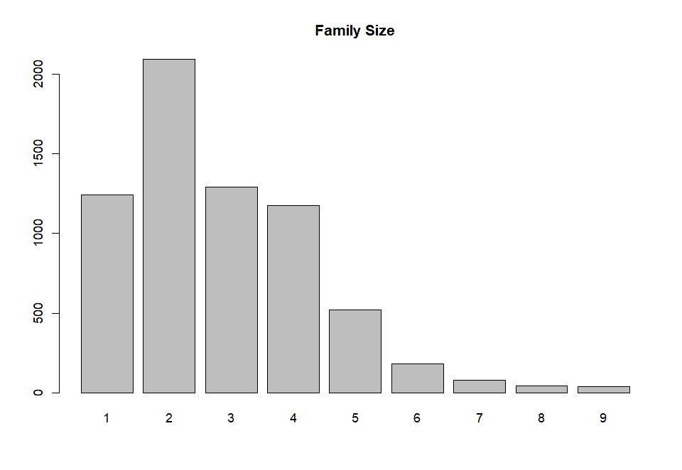
Clientss Shown to have Smaller Families On Average
Notes:
Paul P or Adam

Slide 15
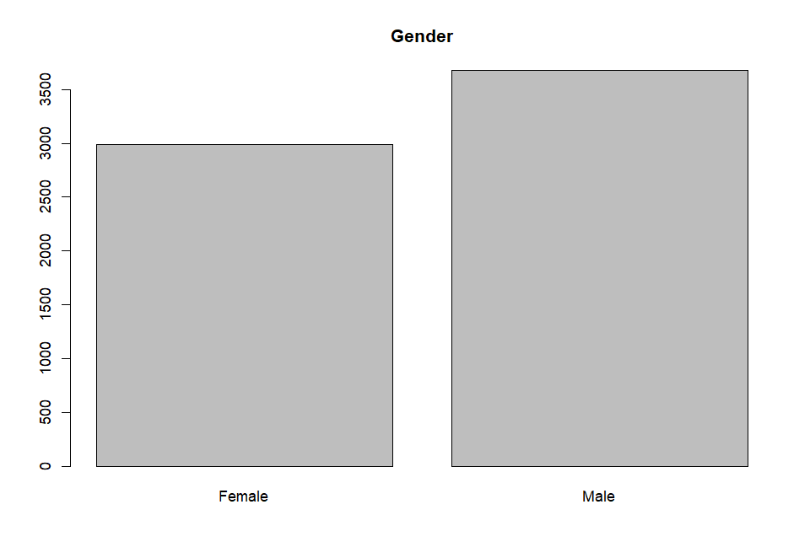
Gender Attribute Is Well Balanced
Notes:
Paul P or Adam

Slide 16
Models and Methods
Arules, Clustering, Classification

Slide 17
Associate Rule Mining
While it will not be our definitive answer to our question we will use rule mining to understand patterns in our data that can lead us in the right direction for figuring out variables to look for in other methods such as
Decision trees
Clustering

Slide 18
Clustering EDA
Training Data Set Segments Existing Clusters into k=4, but is this correct?
If evaluation methods for optimal K suggest should be something else, how to proceed
Recluster training data?
Consider business cases for k=4?
Other considerations
Will utilize elbow method for kModes clustering technique
KModes can be applied to categorical data
Notes:
Paul S

Slide 19
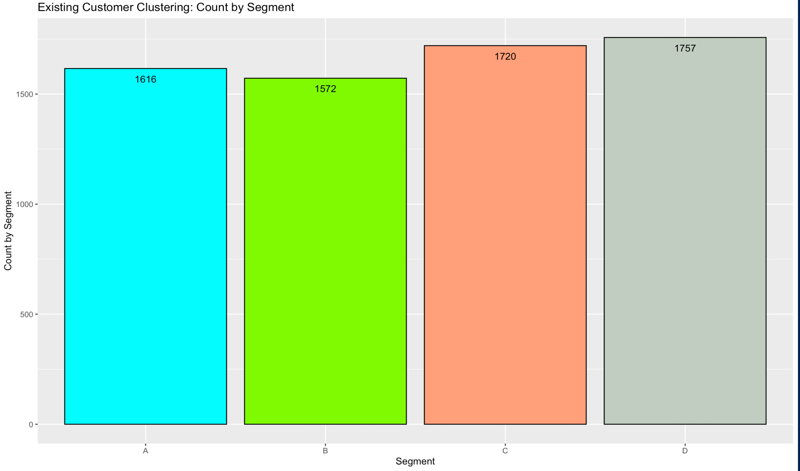
Clustering EDA
.
Notes:
Paul S
This Photo by Unknown author is licensed under CC BY-NC-ND

Slide 20
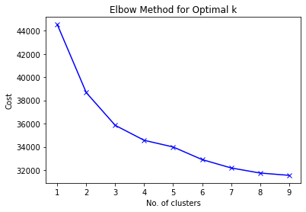
Clustering EDA
Clustering EDA
Notes:
Paul S

Slide 21
Classification Overview
Classification Methods to Consider:
Decision tree methods
Basic – unpruned, pre-pruned, post-pruned
Random Forest
NTrees?
Other Parameter Tuning
Xg Boost
Naïve Bayes
KNN
Determine which evaluation metrics we want to use, apply them to model ouputs, determine best model for prediction
Notes:
Paul S

Slide 22
Resources
Data: Kaggle Page
Terminology
Customer Segmentation & Categories
Spending Score
Decile Ranking in R: dplyr
Visualizing Missingness in R: nianiar

Slide 23
Appendix

Slide 24
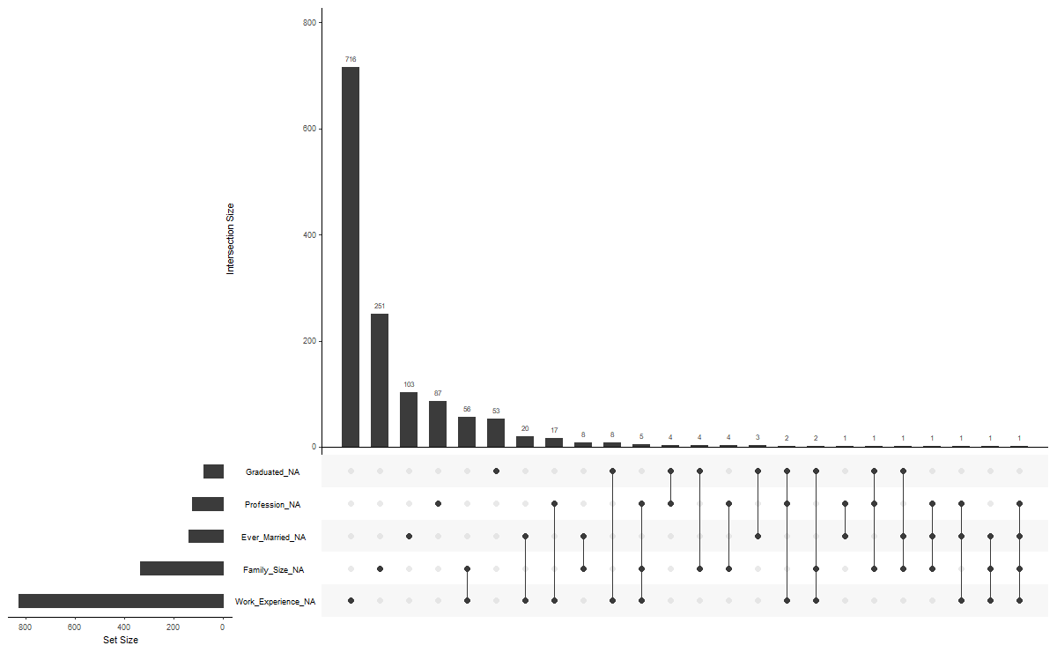
Naniar Project: gg_miss_upset Plot

Slide 25
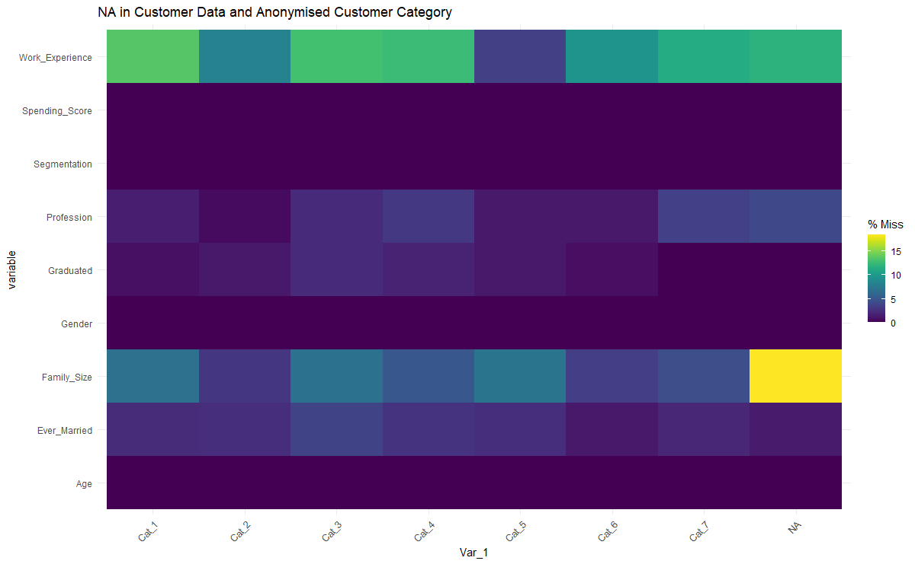
Missing Data Is Consistent Across Categories

Slide 26
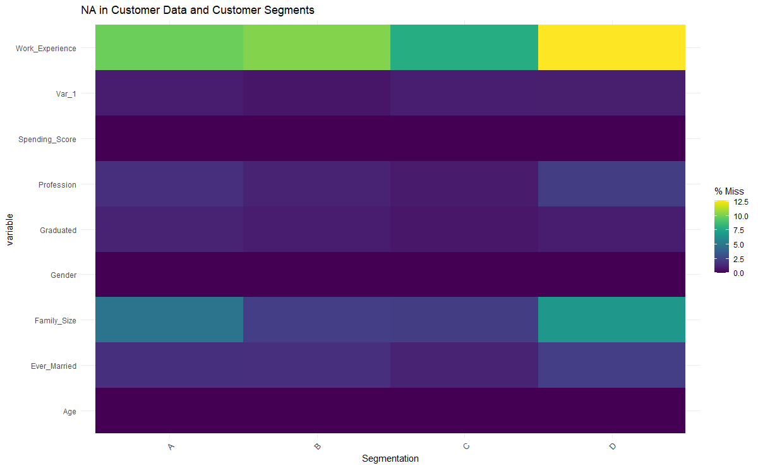
Missing Data Is Consistent Across Segments

